Slide 1
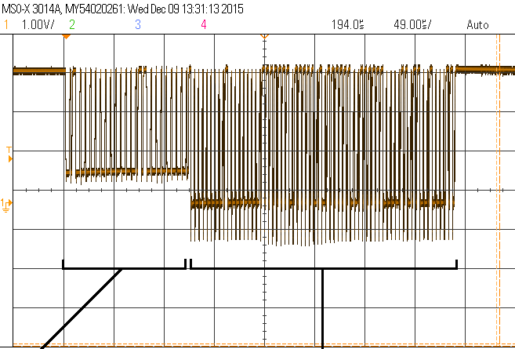
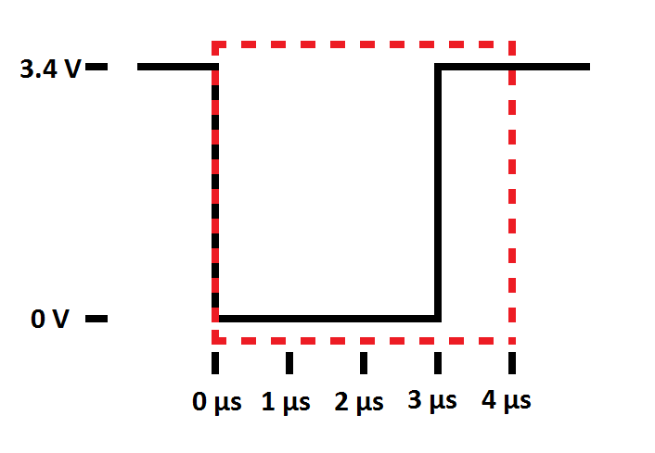
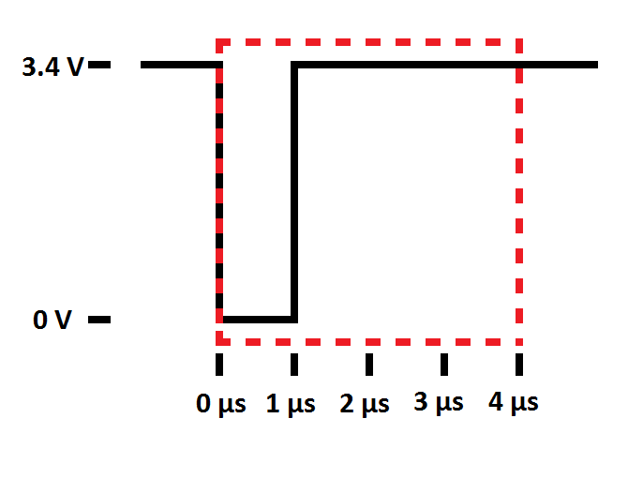
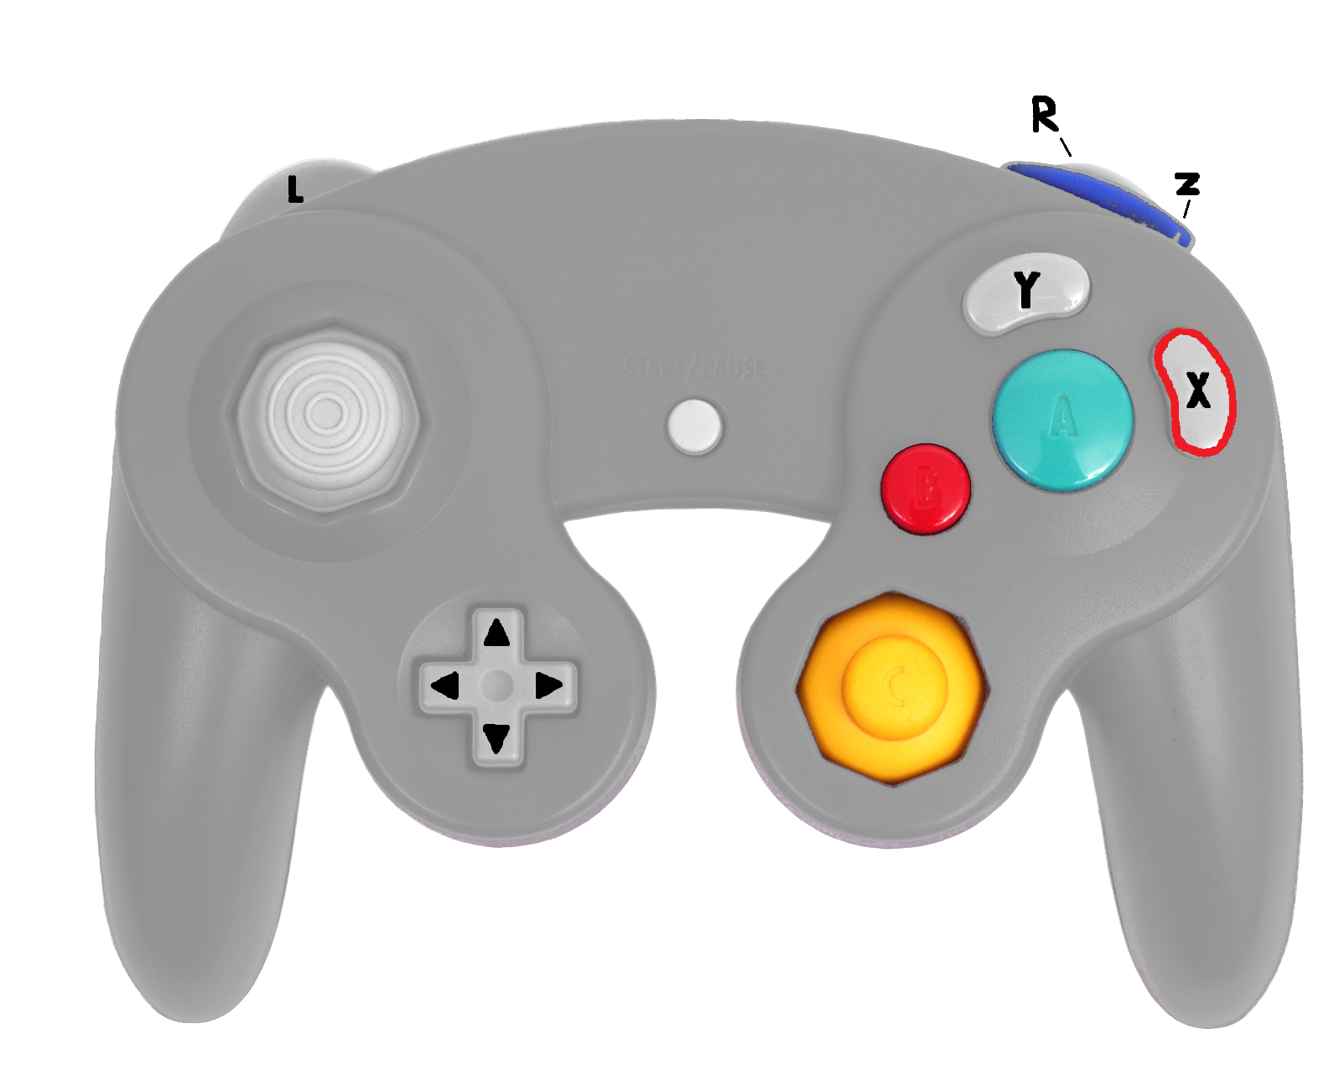
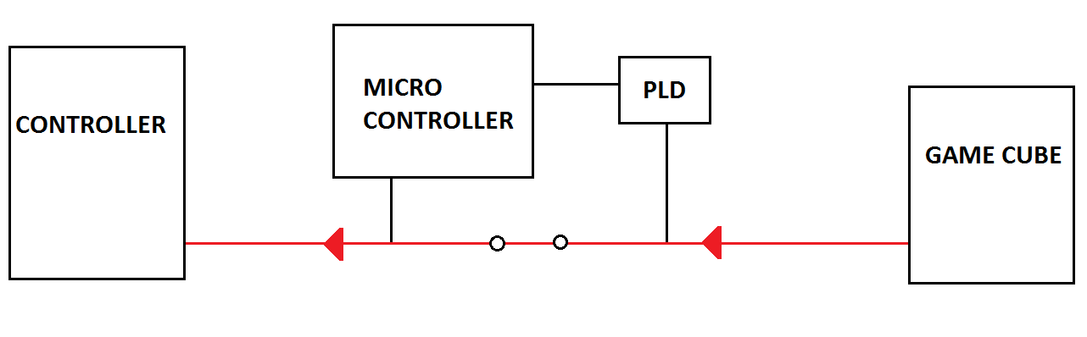
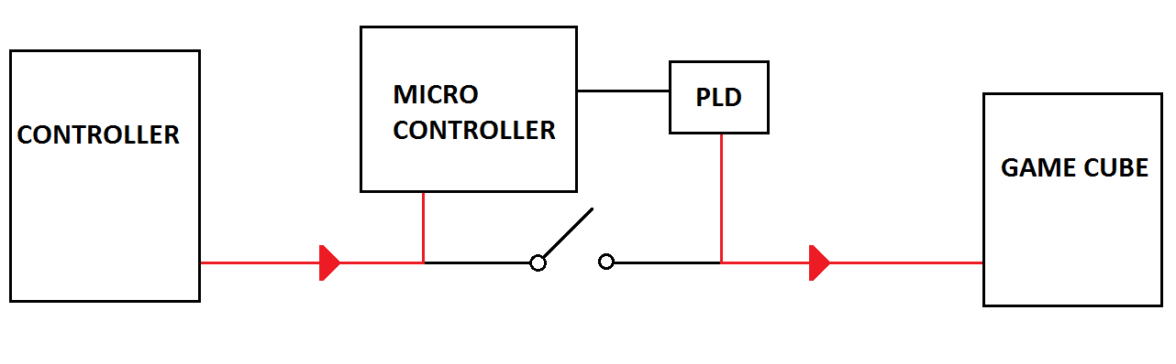
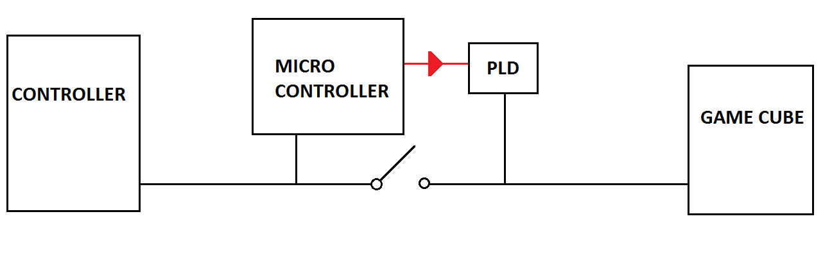
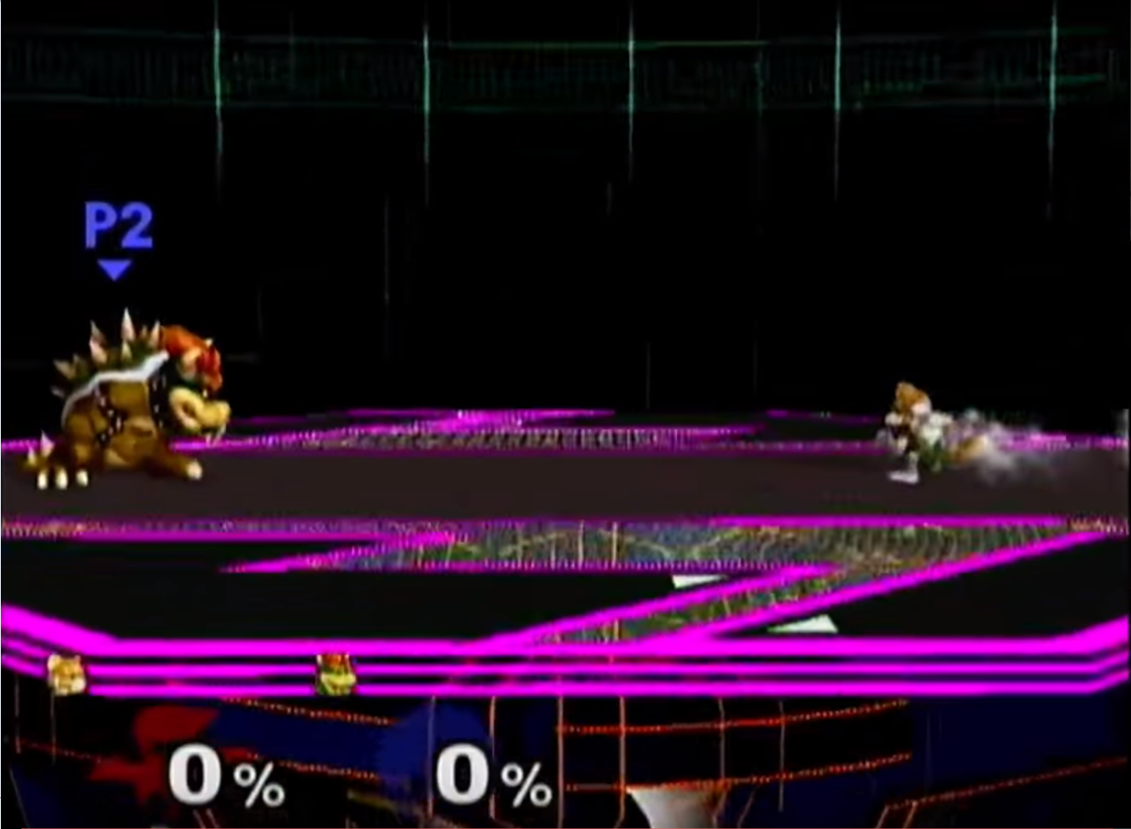
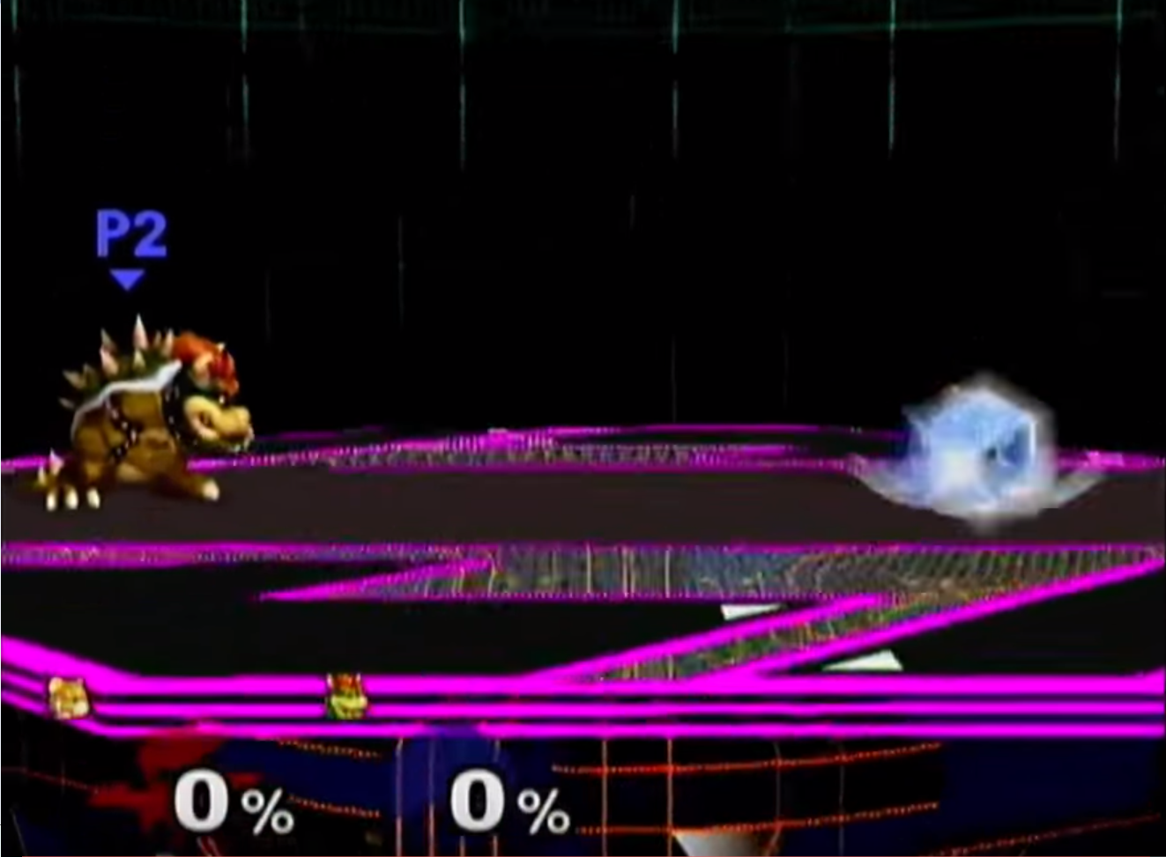
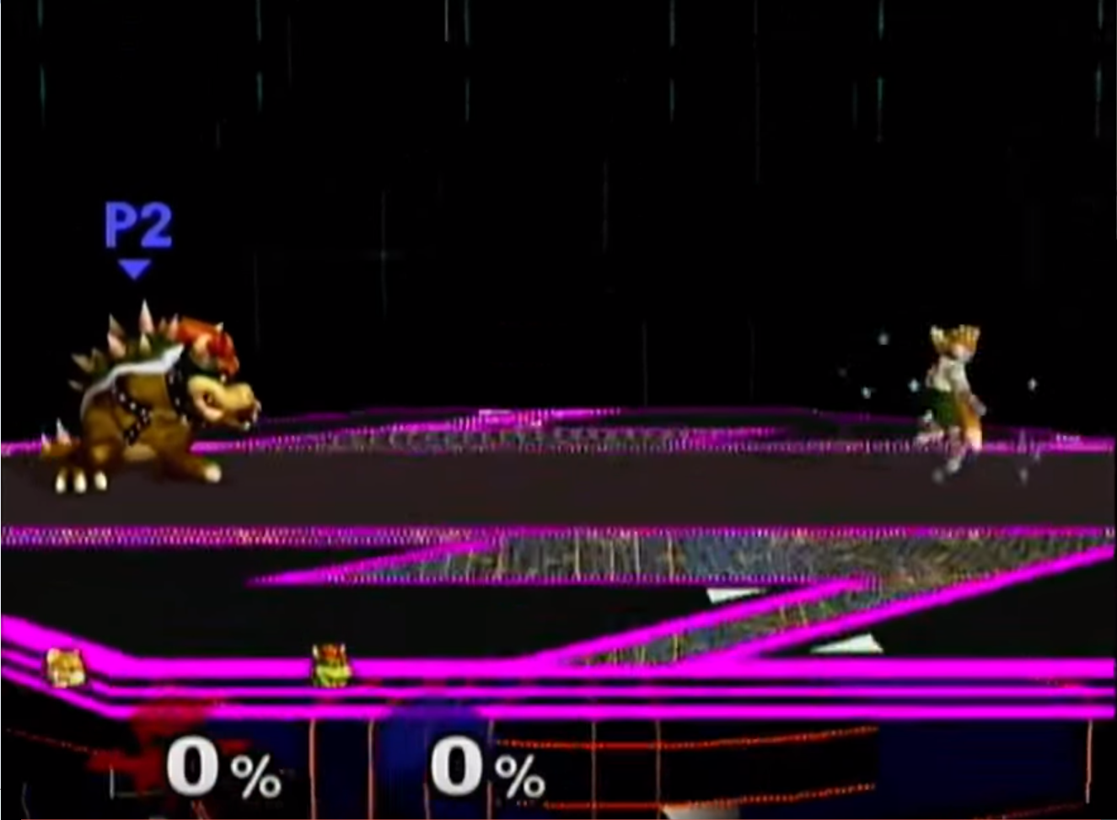
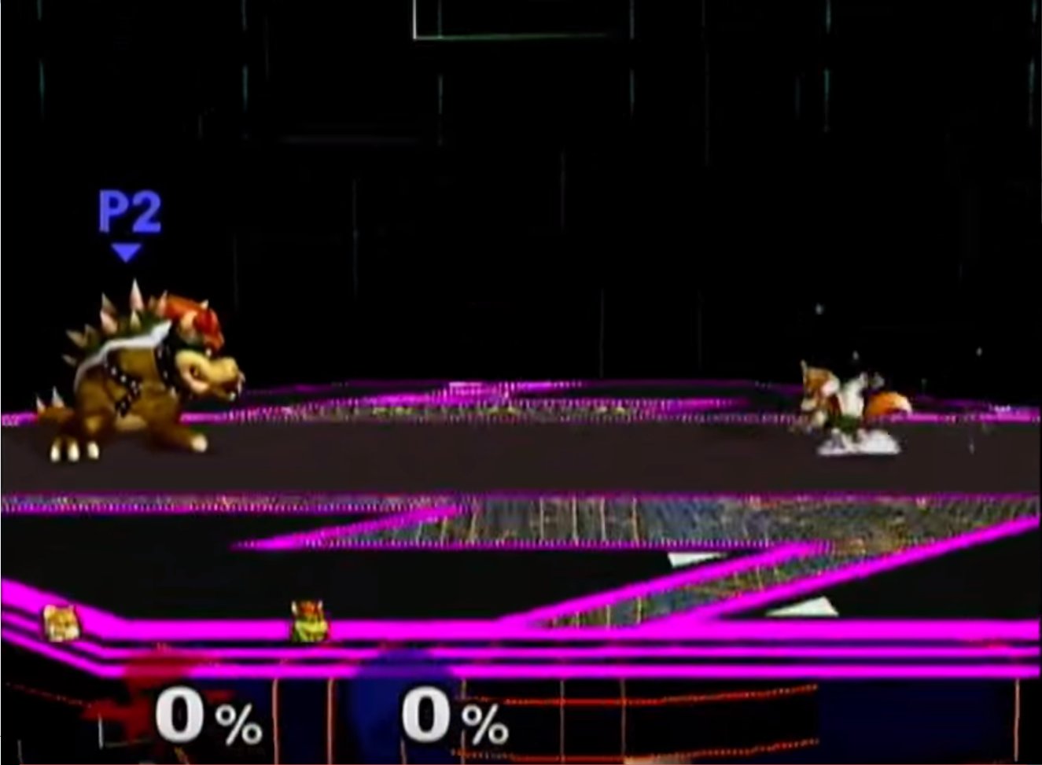
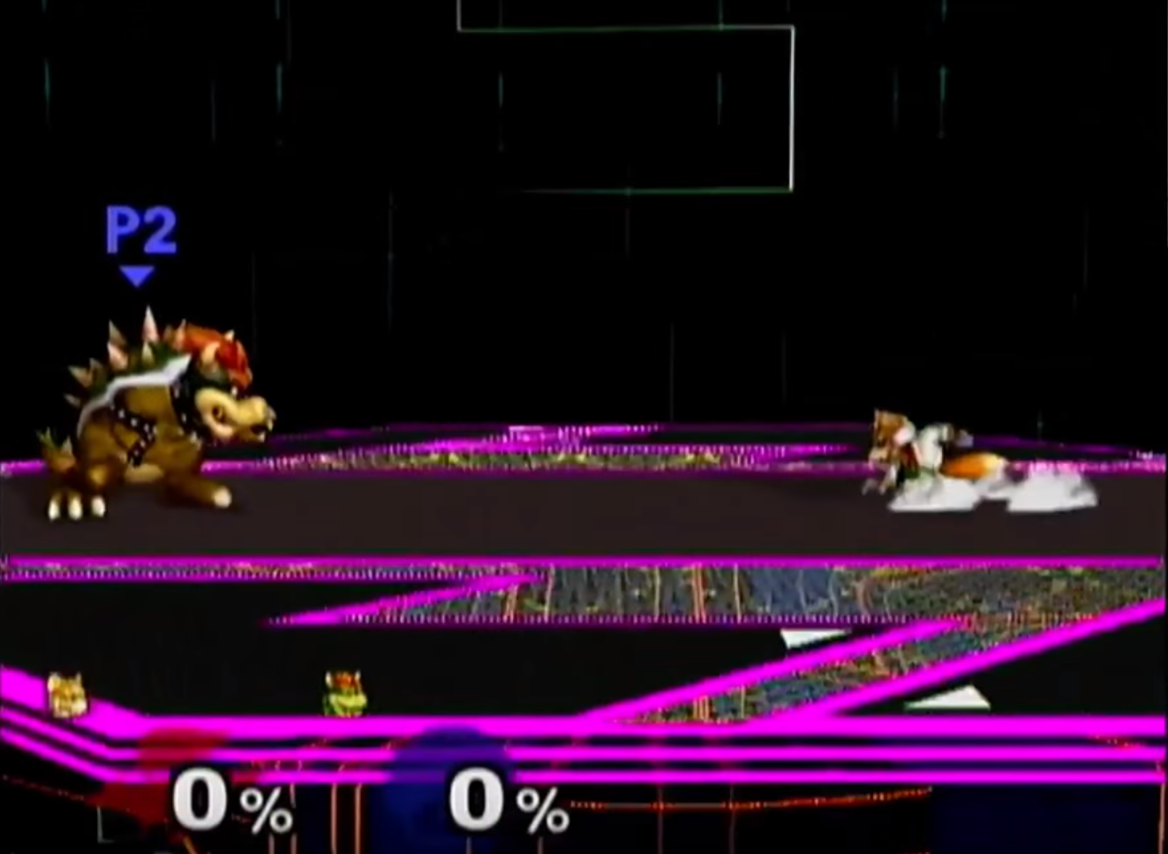
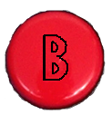
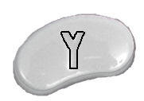
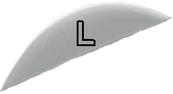

Do you wish you could be Frame Perfect?
A macro controller for the GameCube
What is a GameCube macro?
How does the GameCube talk to the controller?
An automatic sequence of controller inputs that can cause a game to behave in a certain way.
Macros can provide input faster and more precisely than human hands.
This may give a player a competitive advantage and can even be used to create effects and combos that are impossible to do with human input.
Single line master slave protocol
0 bit
1 bit
Gamecube asks for data
Controller responds
How do you start a macro?
How do we intercept the communication?
“Short Hop Double Laser”
“Moon Walk”
Gamecube requests data from
controller
2. Micro reads from controller, PLD
writes previous (possibly altered) data to GameCube*
3. Micro loads PLD with new data
*This adds one cycle (8ms) of delay
“Drill Shine”
“Waveshine”
Macro Button - Hold to enable macros
“Multishine”
Switch between macro schemes
Example of a macro - “Waveshine”
0 ms
no input
31 ms
94 ms
109 ms
156 ms
no input
Jordan Huffaker Eric Colter Kyle Diekhoff Diego De La Fuente
https://www.youtube.com/watch?v=M972kv7pbNk&ab_channel=TheKadiekof
Team 21
ECE 362 Embedded Microcontroller Mini-Project − Fall 2015
Digijock(ette)-Strength Digital System DesignTM

